Slide 1
Sensory Processing
This presentation will help staff:
Understand what sensory processing skills are
Know how you might notice if someone is having difficulties with sensory processing skills
Select activities to support those who are having difficulties

Slide 2
About Sensory Processing Skills
Children learn about their bodies and the environment around them by taking in information from their 7 senses.
When thinking about senses, we often refer to:
Sight
Hearing
Smell
Taste and
Touch
In addition to this, we have sense of:
Movement (vestibular) and
Position of movement (proprioception)
As a child develops, they make sense of this information and lay down motor memories.

Slide 3
About Sensory Processing Skills
Children develop adaptive responses to sensation and this enables attention and the ability to use higher cognitive skills for academic learning.
Some children do not process these senses as effectively as others. This results in difficulties with
Behavioural response
Attention and
Motor skill development.
Children may be over responsive to stimulus, resulting in fight/flight /fright responses, or they may be under responsive, resulting in low arousal or sensory seeking.
A child’s sensory profile can be spiky and can also change. More information on this can be found at www.multisensorylearning.lgfl.net.

Slide 4
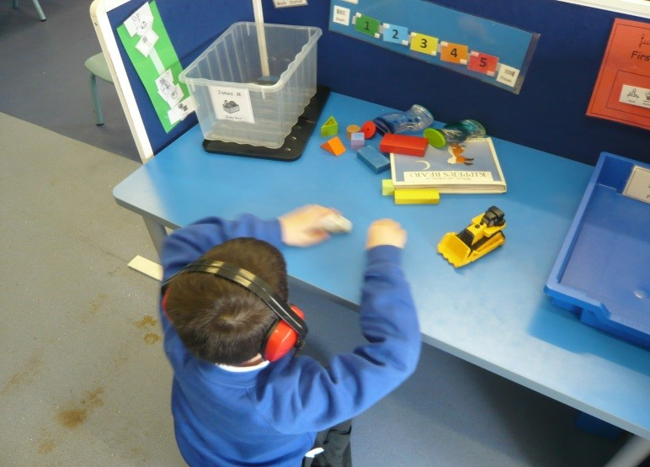
Challenges with Sensory Processing
Difficulty processing sensory information can result in a range of presentations:
Over sensitivity to stimulus
Dislike of noise, touch, taste, smell, movement – more exaggerated response than other children
Emotional outbursts or shut down
Hitting out or running away
Avoidance behaviours
Seeking out certain movements to overcome sensitivity

Slide 5
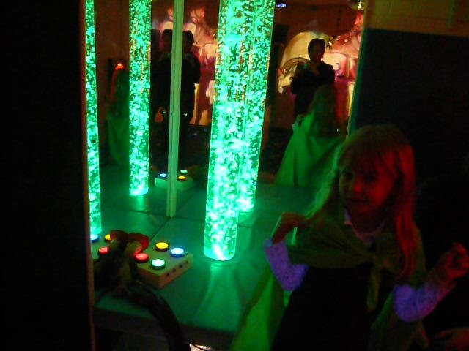
Challenges with Sensory Processing
Difficulty processing sensory information can result in a range of presentations:
Under sensitivity to stimulus (not registering)
Reduced awareness of pain
Lack of response to sound, touch taste, smell or movement
Seeking out additional sensory stimulus to alert themselves
May appear like a daydreamer – often very good temperament
Low muscle tone

Slide 6
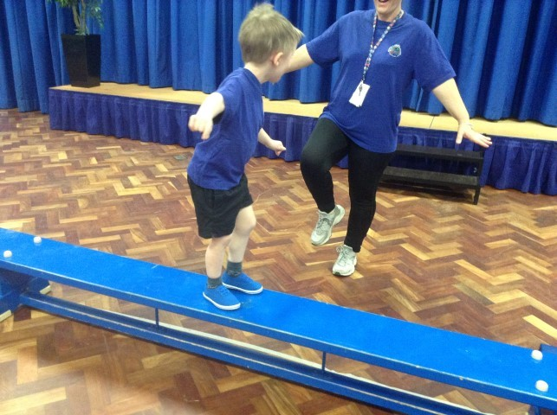
Challenges with Sensory Processing
Difficulty processing sensory information can result in a range of presentations:
Coordination
Difficulties with motor planning and bilateral skills
Slow to learn new movements – more than other children
Delayed motor skills development
Difficulty learning school sport activities
Clowning behaviours or avoidance
Difficulty with self care

Slide 7
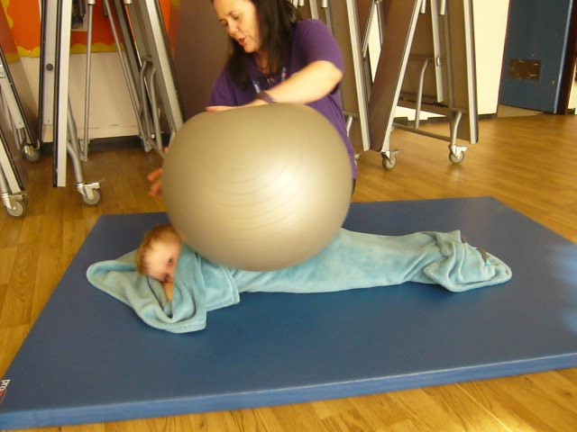
Activities to Support
Activities to support over sensitivity:
Reduce stimulus where possible – sit away from classroom traffic, windows, not too close to peers etc.
Provide activities that will calm the senses:
Deep pressure
Squashy corner in classroom
Jumping
Chair push ups
Class errands involving carrying objects
Warn where possible if there is going to be something strong in stimulus – fire alarm tests, dinner hall smells, changing for PE and so on.

Slide 8
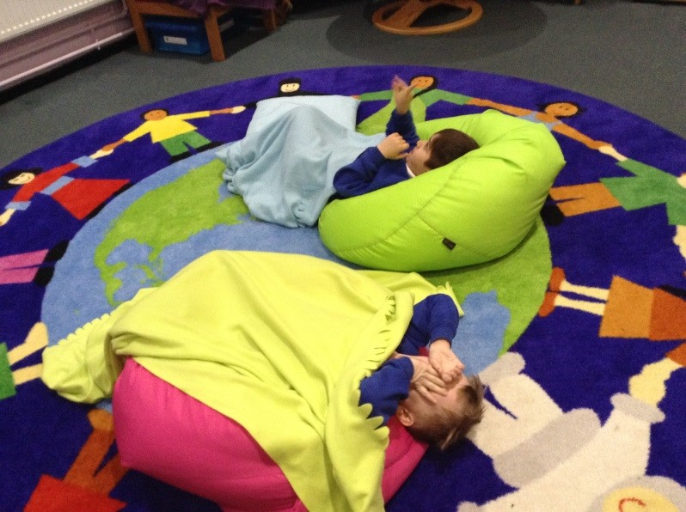
Activities to Support
Activities to support over sensitivity:
Encourage the child to identify feeling over stimulated using a red card or similar indicator for showing that moving away from stimulus is required.
Provide a safe space and be understanding if a child becomes overwhelmed
Be firm in any activity requiring touch
Light touch will activate the protective touch sense, the body’s protective warning system e.g. fight/flight/fear

Slide 9
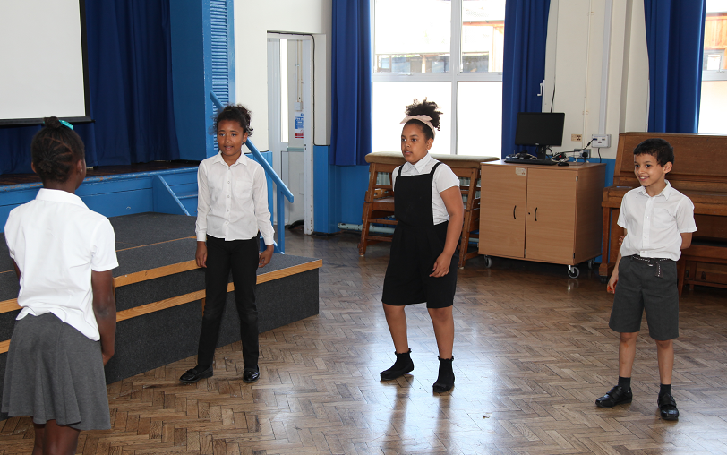
Activities to Support
Activities to support under sensitivity
Ensure learning tasks are presented in a stimulating way
Promote lots of movement to wake up sensory systems - this can reduce sensory seeking behaviours
Don’t assume that passivity is good – check the child has heard instructions etc
Monitor alertness and try to wake up the sensory system of the child if you feel they are under responsive to activity

Slide 10
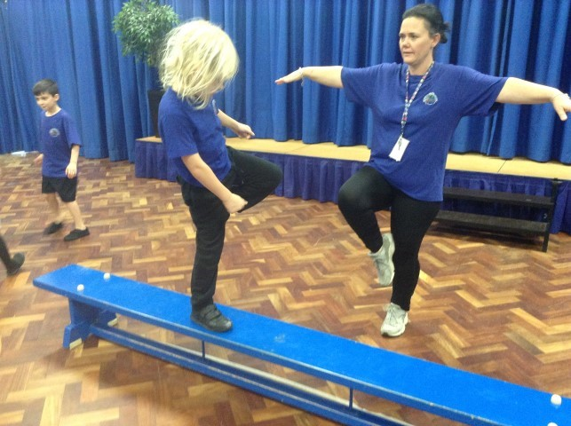
Activities to Support
Activities to support coordination difficulty
Sensory circuits
Hold daily small group sensory circuits for children to practice movements with support in a non competitive way.
This can be done as a breakfast club, lunchtime group or after school activity to prevent impacting learning time but is essential to support their ability to learn skills.
For further information on this, Sheena Rufus recommends ‘Sensory Circuits – A Motor Skills Programme for Children’ by LDA publishers.
This gives a detailed approach to setting up sensory circuits and can be completed by willing TAs, LSAs and teachers.
Complete upper limb and handwriting warm ups (See Movement: Writing) before writing challenges are set – arm raises, arm circles, push hands together, open and close hands, wriggle fingers and so on.

Slide 11
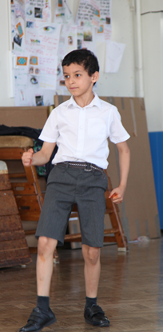
Activities to Support
Activities to support coordination difficulty
Provide visual cues for sequenced activities such as dressing or construction activities.
Promote chair push ups, marching on the spot, jumping on the spot to give the body information about movement and positioning (See Movement: Focus).
Get the child to talk through tasks as they are completing them.
Repeat tasks that are difficult to provide practice.

